Slide 1
PHISHING
“Don’t get hooked. :/ ”
presented by
Team PHISHERMEN
15CSE111 – Computer Science Essentials

Slide 2
PHISHERMEN ><>’
VINAY VARMA NADIMPALLI
MACHIRAJU SRIVASTHASVA SRINIVAS
VENU VARDHAN REDDY TEKULA
AM.EN.U4CSE16505
AM.EN.U4CSE16506
AM.EN.U4CSE16508

Slide 3

AGENDA
about Phishing
Losses
Stages
Identifications
preventive measures
Conclusion

Slide 4

Phishing????
TRAP

Slide 5
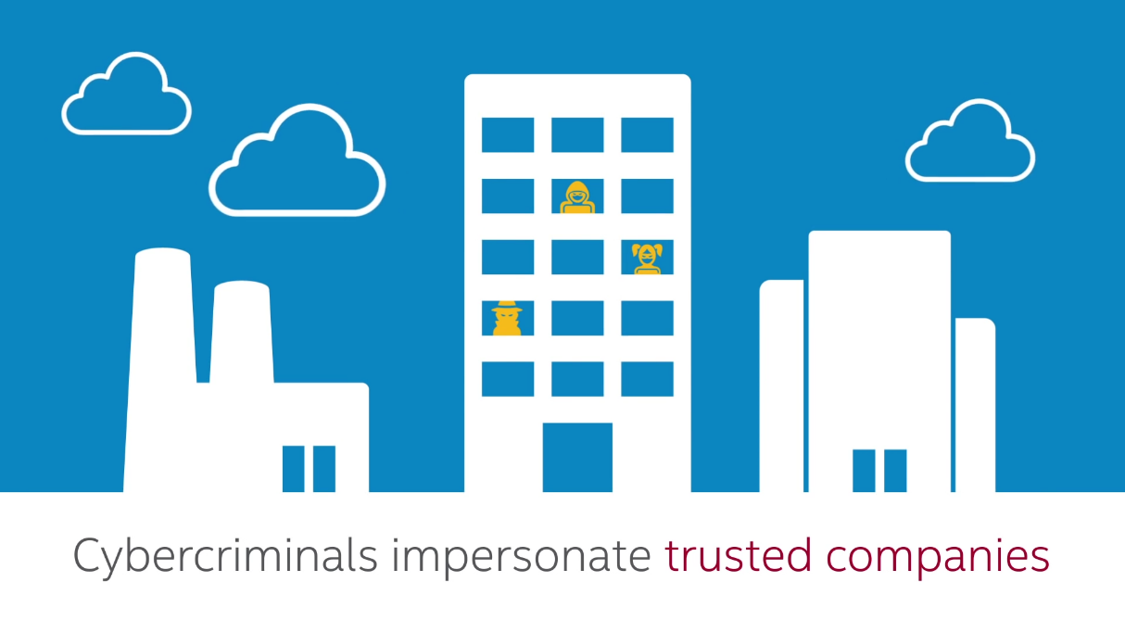
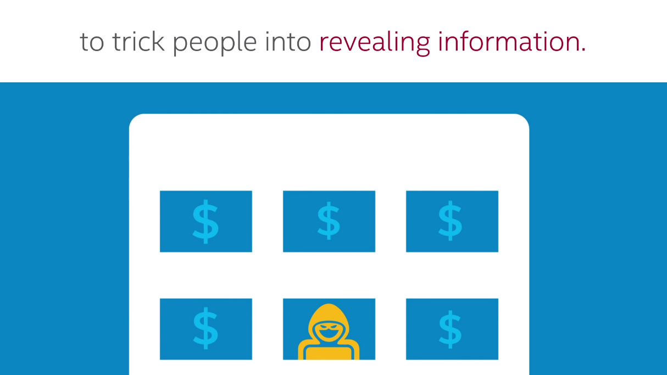

Phishing is the attempt to obtain sensitive information such as usernames, passwords, and credit card details (and, indirectly, money), often for malicious reasons, by disguising as a trustworthy entity in an electronic communication.

Slide 6
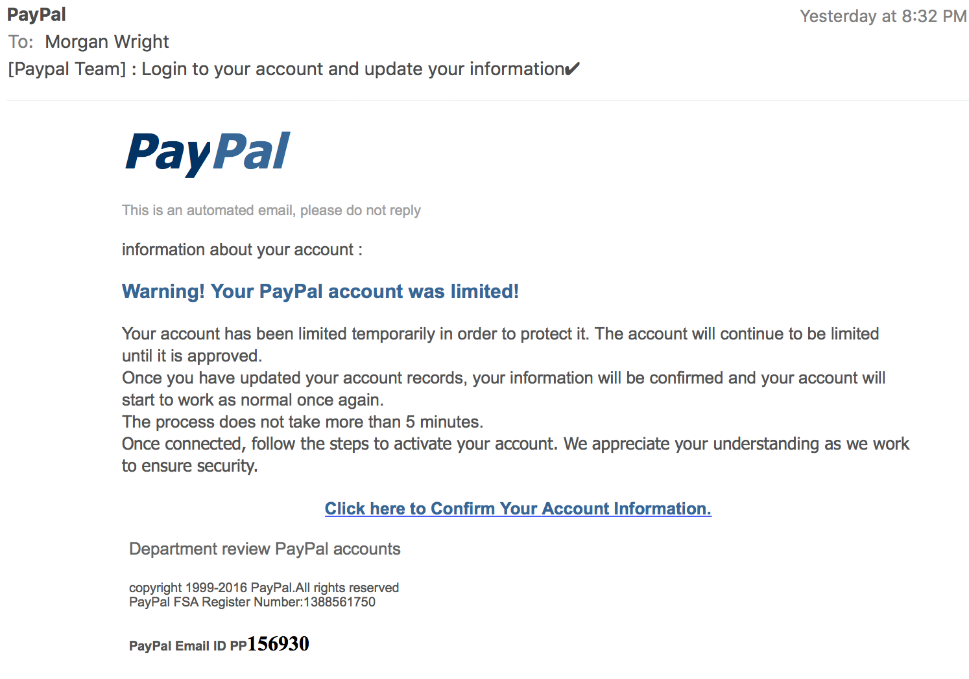

Slide 7
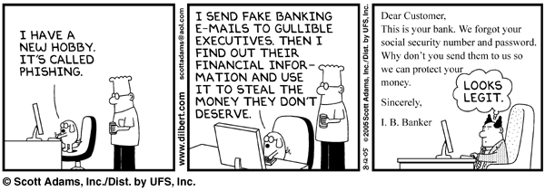
so popular..

Slide 8




Basic anatomy of Phishing
STAGE 1 – The Bait
STAGE 2 – Gone Phishing
STAGE 3 – The Catch

Slide 9

The Bait - Target
The criminals target popular brands with a strong online presence that is most likely to yield them a good return.

Slide 10
Gone Phishing – Making the trap
Steps to follow:
Creating undetectable facebook phishing page.
URL Masking/Hiding and send it to victim.
Create an account in free web hosting site and upload the phisher files.
http://picateshackz.com/2015/12/undetectable-facebook-phishing-page.html

Slide 11
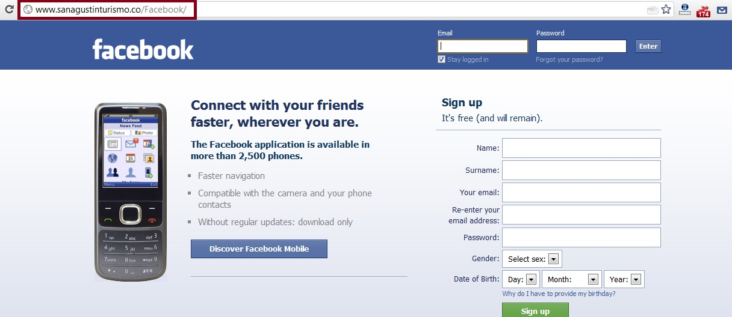

Slide 12
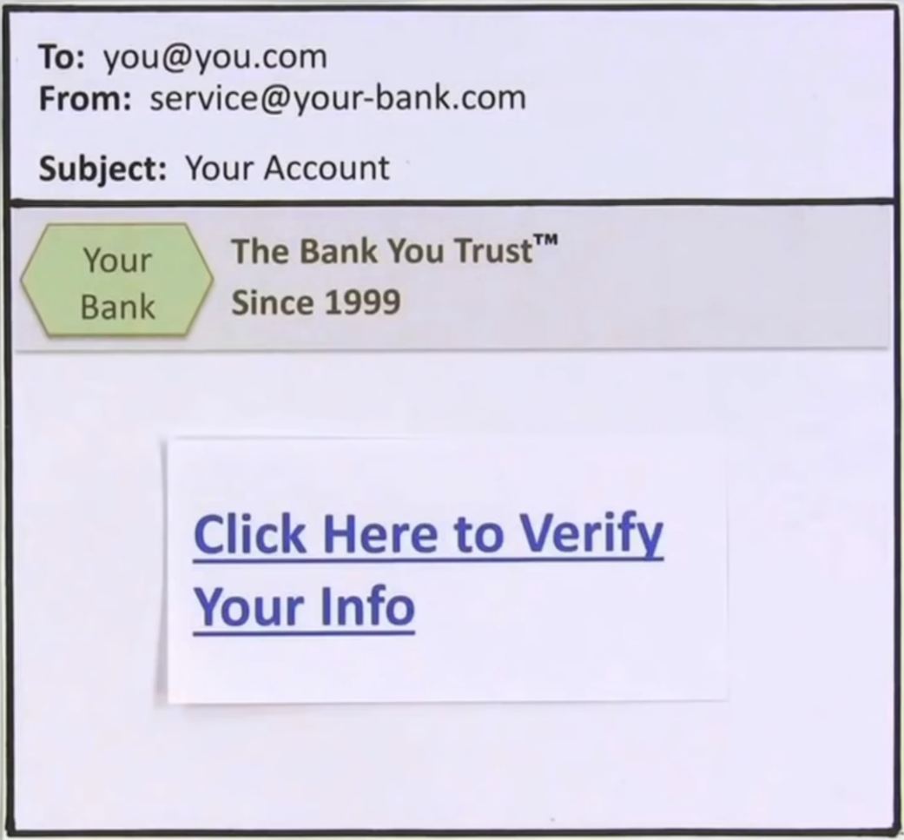
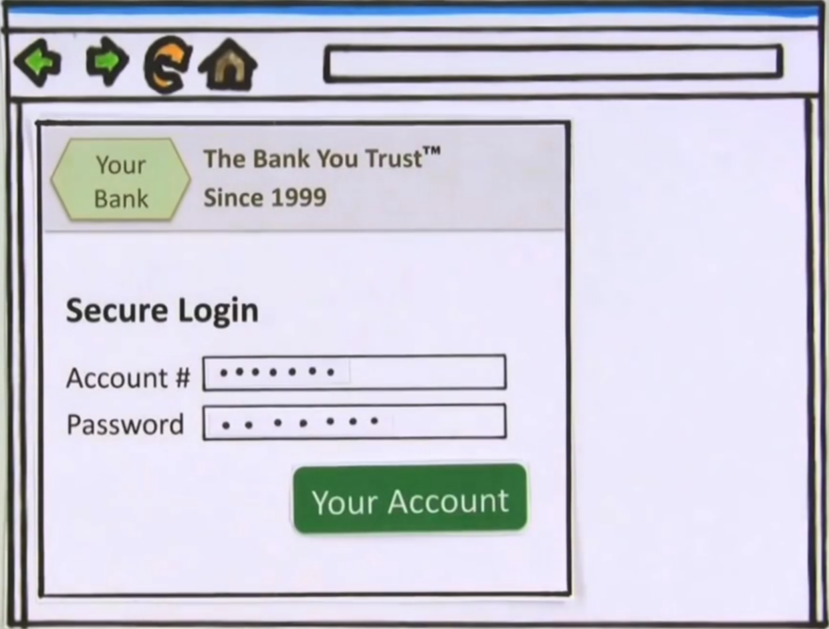
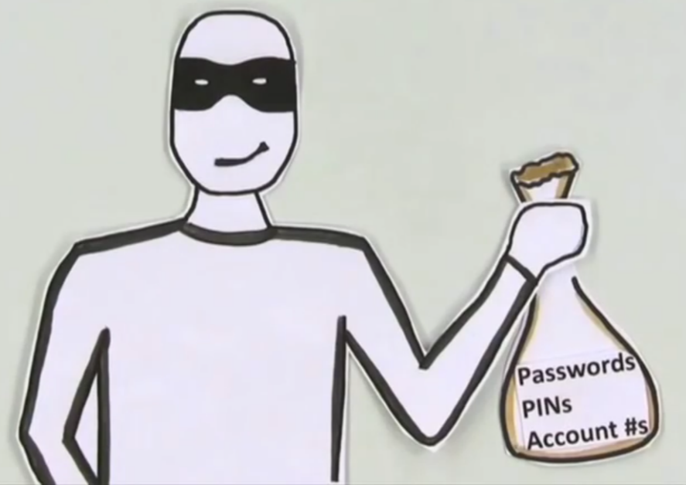
The Catch – Trap time

Slide 13
DOES IT MATTER?
-_-
Yes, It DOES!

Slide 14
TELLTALE SIGNS
It’s easy..
Make sure sender’s email address matches their official website address.
Spelling errors and bad grammar are common in fake messages.
Be wary of generic titles such as “valued customer” instead of your name.
Double-check URLs in emails and text messages before you click.
Ignore any request for any personal and financial information.

Slide 15

Look for lock symbol and
and “https.”
The “s” stands for “secure”.

Slide 16
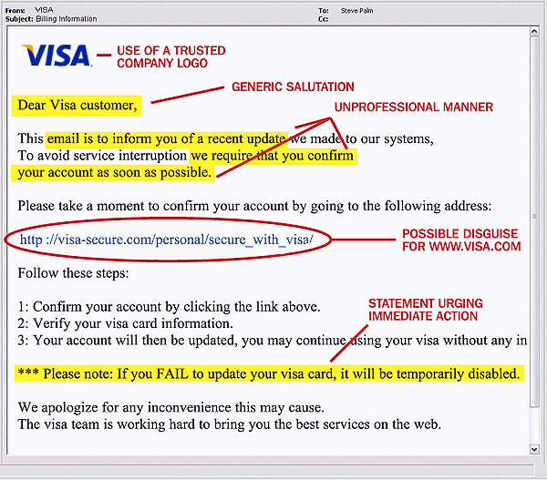

Slide 17

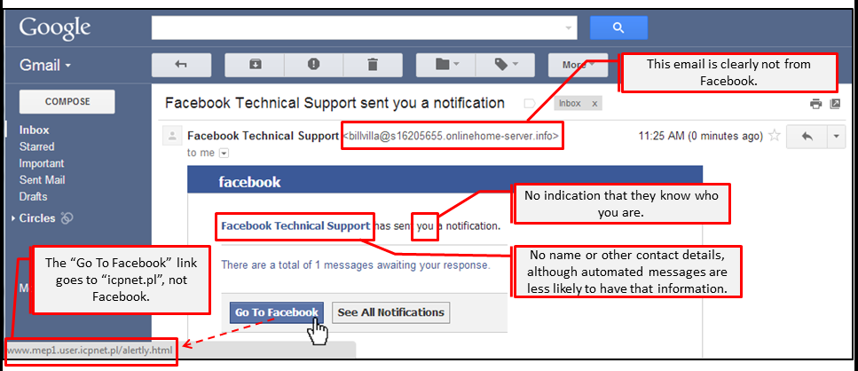
facebook

Slide 18
Anti-phishing
anti-phishing websites like www.fraudwatchinternational.com .
report the spam mails to reportphishing@antiphishing.org .
by using phishing tools like Super Phisher.
train people to recognize phishing attempts, and to deal with them.
Install security software on all your devices to identify and block phishing scams.

Slide 19

Protect yourself!!
Follow the CAUTIONS.
BEFORE YOU CLICK, CHECK
FOR HACKERS’ TRICKS.

Slide 20

Recognize Phishing
and leave cybercriminals high and dry!!

Slide 21

WHEN IN DOUBT DO NOT CLICK
STAY COOL AND BE SAFE

Slide 22
any queries?? 😐

Slide 23
Resources :
https://en.wikipedia.org/wiki/Phishing
http://www.getcybersafe.gc.ca/
http://computer.howstuffworks.com/phishing.htm
http://www.phishing.org/what-is-phishing
http://picateshackz.com/

Slide 24
Thank you!! :)

